Slide 1
Incident and Disaster Response
Corporate Computer Security
Randall J. Boyle & Raymond R. Panko
(Adapted)

Slide 2
Incident and disaster response
Business continuity
IT disaster recovery
Case study incident response TBA
Case study disaster recovery - hurricane Katrina and the Walmart response

Slide 3
Incidents (Breaches, Compromises): Successful attacks
Beyond the capabilities of on-duty staff
Must convene a Computer Security Incident Response Team (CSIRT). CSIRT needs participation beyond IT security
CSIRT Should be led by a senior manager and should have members from affected line operations
Might need to communicate with the media; only do so via public relations. Corporate legal counsel must be involved to address legal issues
Human resources is necessary, especially if there will be sanctions against employees

Slide 4
Planning Before an Incident or Disaster
Decide what to do ahead of time
Time to consider matters thoroughly and without the time pressure of a crisis
During an attack, human decision-making skills degrade
Incident response is reacting to incidents according to plan
Must have flexibility within the plan to adapt
Best to adapt within a plan than to improvise completely

Slide 5
Effective Response: Speed and Accuracy
Speed of response can reduce damage
Attacker will have less time to do damage
The attacker cannot burrow as deeply into the system and become very difficult to detect
Speed is also necessary in recovery
Accuracy is equally important
Common mistake is to act on incorrect assumptions
If problem is misdiagnosed or the wrong approach is taken, can make things much worse
Take your time quickly

Slide 6
Rehearsals and tests
Team Members Must Rehearse the Plan
Rehearsals find mistakes in the plan
Practice builds speed
Types of Rehearsals
Walkthroughs (table-top exercises)
Live tests (actually doing planned actions) can find subtle problems, but are expensive

Slide 7
The Incident Response Process for Major Incidents
Detection, Analysis, and Escalation
Must detect through technology or people
Need good intrusion detection technology
All employees must know how to report incidents
Must analyze the incident enough to guide subsequent actions
Confirm that the incident is real
Determine its scope: Who is attacking; what are they doing; how sophisticated they are, etc.
Escalate , if appropriate to the DR Team, BS team, CSIRT

Slide 8
The Incident Response Process: CONTAINMENT
Disconnection of the system from the site network or the site network from the Internet (damaging)
Harmful, so must be done only with proper authorization
This is a business decision, not a technical decision
Black holing the attacker (only works for a short time)
Continue to collect data to understand the situation (allows harm to continue)
Especially necessary if prosecution is desired

Slide 9
The Incident Response Process: RECOVERY (1)
Repair during continuing server operation
Avoids lack of availability
No loss of data
Risky: e.g., possibility of a rootkit not having been removed
Data
Restoration from backup tapes
Loses data since last trusted backup

Slide 10
The Incident Response Process: RECOVERY (2)
Software
Total software reinstallation of operating system and applications may be necessary for the system to be trusted
Manual reinstallation of software
Need installation media and product activation keys
Must have good configuration documentation before the incident
Reinstallation from a disk image
Can greatly reduce time and effort
Requires a recent disk image

Slide 11
The Incident Response Process: RECOVERY (3)
Apology
Acknowledge responsibility and harm without evasion or weasel words
Explain potential inconvenience and harm in detail
Explain what actions will be taken to compensate victims, if any

Slide 12
The Incident Response Process: PUNISHMENT
Punishing employees is usually fairly easy. However, this may vary internationally. Union agreements may limit sanctions or at least require more detailed processes.
The decision to pursue criminal prosecution. However, it must consider cost and effort, probable success if pursued (e.g., if attackers are minors, or foreign nationals), loss of reputation because the incident becomes public
Involves collecting and managing evidence. Courts have strict rules for admitting evidence in court so, call the authorities and a forensics expert for help. Try to protect evidence, i.e., “pull the plug” on a server if possible (a business, not an IT only, decision). Document the chain of custody (who held the evidence, what they did to protect it).

Slide 13
The Incident Response Process: POST-MORTEM EVALUATION
What should we do differently next time?

Slide 14
Disasters
Disasters
Fires, floods, hurricanes, major terrorist attacks
Must assure business continuity
Maintaining the day-to-day operations of the firm
Requires a business continuity group headed by a senior manager
Core permanent staff will facilitate activities
IT disaster response is restoring IT services
May be a subset of business continuity
May be a stand-alone IT disaster

Slide 15
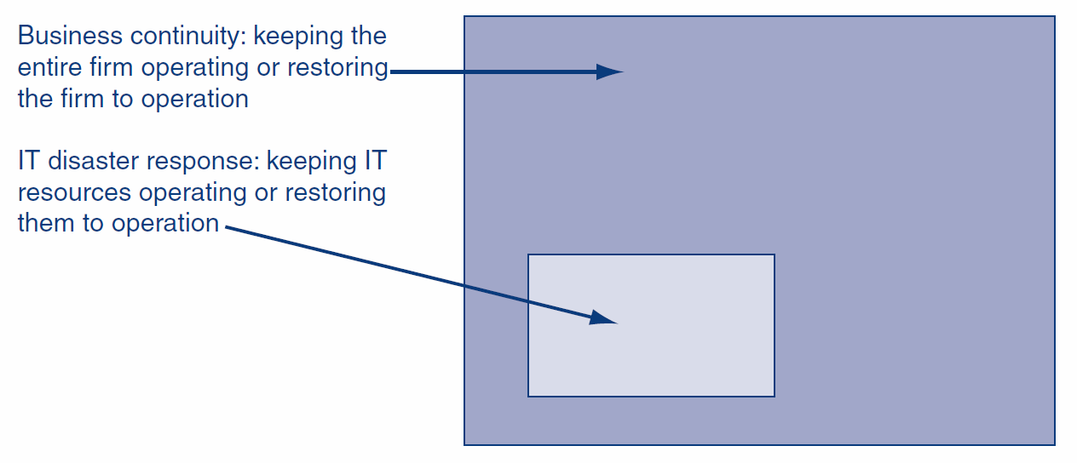
BC Planning (BCP)
A business continuity plan specifies how a company plans to restore or maintain core business operations when disasters occur.
Disaster response is restoring IT services.

Slide 16
BCP Principles
Protect people first: Evacuation plans and drills. Never allow staff members back into unsafe environments. Must have a systematic way to account for all employees and notify loved ones. Counseling afterwards
People have reduced capacity in decision making during a crisis. Planning and rehearsal are critical. However, avoid rigidity: Unexpected situations will arise, communication will break down and information will be unreliable. Decision makers must have the flexibility to act

Slide 17
BCP Principles
Communication: Try to compensate for inevitable breakdowns. Have a backup communication system. Communicate constantly to keep everybody “in the loop”.
Business Process Analysis: Identification of business processes and their interrelationships in order to prioritize restoring them, according to: Downtime tolerance, Importance to the firm, Required by a higher-importance process.

Slide 18
BCP testing and updating
Testing: Difficult because of the scope of disasters & the number of people involved
Updating: Bsiness conditions change and businesses reorganize constantly. People who must execute the plan also change jobs constantly. Telephone numbers and other contact information must be updated far more frequently than the plan as a whole. Ideally, should have a small, permanent staff assigned to it .

Slide 19
IT Disaster Recovery
Looks specifically at the technical aspects of how a company can get its IT back into operation using backup facilities. It is subset of business continuity or for disasters that only affect IT
All decisions are business decisions and should not be made by IT or IT security staff

Slide 20
IT Disaster Recovery: BACKUP FACILITIES
Hot sites: Ready to run (e.g., power, HVAC, computers) - just add data. Rapid readiness but at a high cost. Also, must be careful to have the software at the hot site up-to-date in terms of configuration.
Cold sites: Building facilities, power, HVAC, communication to outside world only. No computer equipment. Less expensive but usually take too long to get operating
Site sharing: Among a firm’s sites. Has the problem of equipment compatibility and data synchronization). Continuous data protection needed to allow rapid recovery.

Slide 21
IT Disaster Recovery: STAFF and DATA
Office Computers: Hold much of a corporation’s data and analysis capability. Will need new computers if old computers are destroyed or unavailable. Will need new software. Well-synchronized data backup is critical.
Restoration of Data and Programs: Restoration from backup tapes; need backup tapes at the remote recovery site. May be impossible during a disaster
Testing the IT Disaster Recovery Plan: Difficult and expensive but necessary

Slide 22
Case study: Walmart and Hurricane Katrina
Hurricane Katrina devastated New Orleans in 2005. The U.S. Federal Emergency Management Administration (FEMA) botched the relief effort
However, Walmart (the largest retailer in the U.S.):
Supplied $20 million in cash
Supplied 100,000 free meals
1,900 truckloads full of diapers, toothbrushes, other emergency supplies
45 trucks were rolling before the hurricane hit land
Provided police and relief workers with flashlights, batteries, ammunition, protective gear, and meals

Slide 23
Walmart and Hurricane Katrina: an example of an DRP plan in action
Walmart Business Continuity Center
A permanent department with a small core staff
Activated two days before Katrina hit
Soon, 50 managers and specialists were at work in the center
Before computer network went down, sent detailed orders to its distribution center in Mississippi
Recovery merchandise for stores: bleach, mops, etc.
40 power generators to supply stores with backup power
Sent loss-prevention employees to secure stores

Slide 24
Walmart and Hurricane Katrina
Communication
Network communication failed
Relied on telephone to contact its stores and other key constituencies
Response
Stores came back to business within days
Engaged local law enforcement to preserve order in lines to get into stores

Slide 25
Walmart and Hurricane Katrina
Preparation
Full-time director of business continuity
Detailed business continuity plans
Clear lines of responsibility
Multitasking
During all of this, also monitored a hurricane off Japan

